Slide 1

LAB#03
Artificial Intelligence
Abdul Haseeb

Slide 2
Lab Objectives
Dictionaries
Functions
Numpy Library
Tuple

Slide 3
Tuple
Tuples is collection of objects like list in python
Unlike lists tuples are immutable
Whenever you want to create a collection that shouldn’t change you should go for tuples

Slide 4
Tuple Objectives
Creating a tuple
Accessing elements of a tuple
Trying to update tuple
Removing elements from a tuple
Checking if a value exists in tuple
Traversing a tuple

Slide 5
Dictionary
It is a key value pair
Each key value pair is called an item
Dictionaries are mutable
These provide fast lookup in O(1) time

Slide 6
Dictionary Objectives
Creating elements in dictionary
Accessing elements from a dictionary
Updating elements of a dictionary
Adding new elements
Removing elements from a dictionary
Checking if a key exists
Getting keys and values
Merging Dictionaries

Slide 7
Functions
Function is a block of code, which takes certain input(arguments may not be necessary) processes it and produces some output (print or return)
Functions provide modularity and reusability

Slide 8
Function Objectives
Defining and calling functions
Function Arguments
Return Values from a function
Global keyword

Slide 9
LAB TASKS
TASK 01: Create a function which takes tuples of tuples as input (containing at least 7 tuples), where each tuple contains: name and age of a person, this function returns a new tuple which contains only the names of those persons whose age is greater than 20
TASK 02: Create a function which takes a number as input and determines two things:
Whether the number is even/odd
Greater than 5, as a bool

Slide 10
LAB TASKS
TASK 03: Create a function which stores the information about books in Library:
Each book has title,author,publication year and genre
Use a dictionary to store information about the books
Where keys are the book titles
Values are title,author,publication year and genre as a tuple
Write Separate functions for:
Searching a book and display it’s information
Adding a new book
Deleting a book with given key

Slide 11
Numpy Library
In Python we have lists that serve the purpose of array
But being heterogenous these are slow to process
Numpy provides an array object that is 50x faster in processing than the lists:
Array object is called ndarray

Slide 12
Numpy Objectives
Creating Numpy arrays
Array Operations
Array Manipulations
Advanced Topics

Slide 13
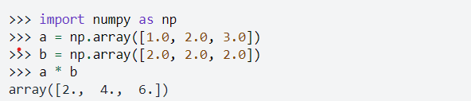
Broadcasting
Numpy allows operations on arrays of different shapes with certain constraints

Slide 14
